Slide 1
Python Basics

Slide 2
Basics of Python for Data Analysis
Open Source – free to install
Very easy to learn
Can become a common language for data science and production of web based analytics products.
It is an interpreted language and compiled language

Slide 3
Python Properties
Strongly typed. It enforces data types so you can’t concatenate a string and a integer, for example.
Dynamically, implicitly typed. So, you don’t have to explicitly declare variable data types. Data types are enforced at runtime.
Case sensitive. For example, token and TOKEN are two different variables.
Object-oriented.

Slide 4
Python inventor
Guido Van Rossum inventor of Python
General Purpose programming language
Build anything
Can build packages for data science

Slide 5
Python Framework
Anaconda Framework
Jupyter Notebook
Python 3.x
Operating system version
Mac:
Linux:
Windows:

Slide 6
Python script
Python Files -.ipynb
List of Python commands
Executing the script

Slide 7
Python basic syntax
>>> 3+4
7
>>> 4*4
16
>>> 5-2
3
>>> 8/2
4.0
>>> a=9
>>> b=2
>>> c=a+b
>>> print(c)
11

Slide 8
python calculator
>>> print(8+2)
print(5 + 5)
print(5 - 5)
# Multiplication, division, modulo, and exponentiation
print(3 * 5)
print(10 / 2)
print(18 % 7)
print(4 ** 2)

Slide 9
Print -String
>>> print ('hello world')
hello world
Print(“hello world”)
Hello world

Slide 10
Variables
Variables are containers for data.
The syntax to declare them is:
variable_name = variable_value.
X=25
Y=69
Z=80

Slide 11
Variables example…
number1 = 50
number2=100
Result=number1 +number2
First=45
Second=5
Third=First+Second

Slide 12
Variables
>>> var1=89
>>> print(var1)
89
>>> var2='Hello'
>>> print(var2)
Hello
>>> addvar=8+5
>>> print(addvar)
13

Slide 13
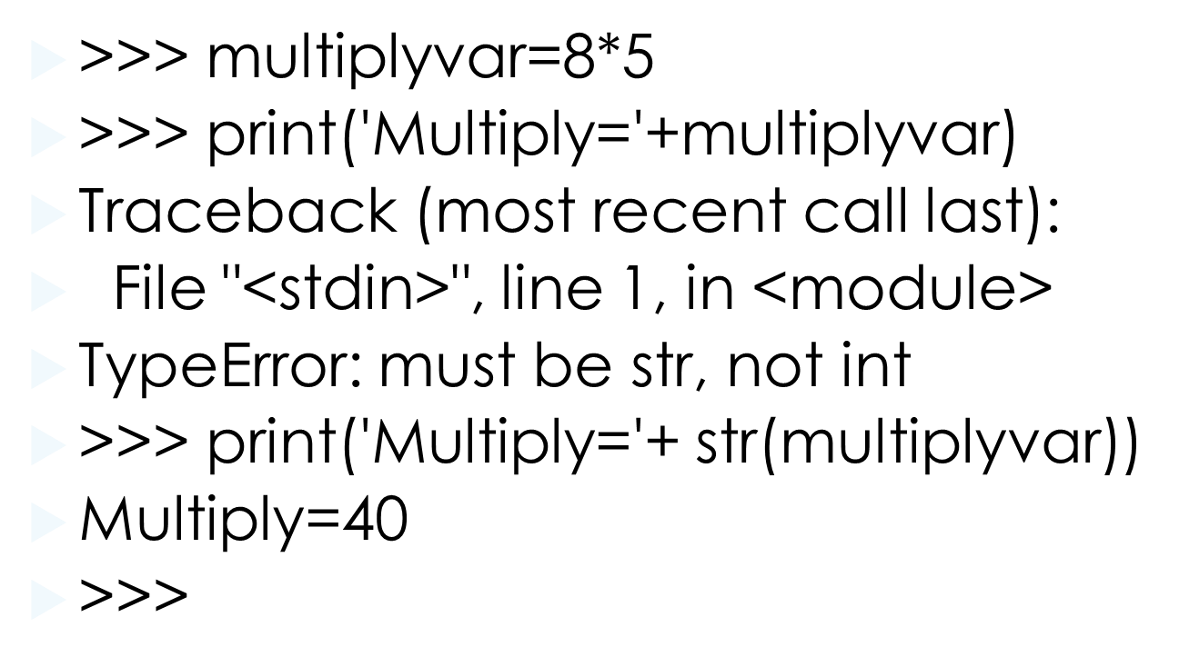

Slide 14
Built-in Data Types
Python has a number of built-in data types such as numbers (integers, floats, complex numbers), strings, lists, tuples, and dictionaries.
Each of these can be manipulated using:
Operators
Functions

Slide 15
Numbers
Numbers can be integers, floating points, Booleans, or complex numbers. The former three are the most important:
Integers are whole numbers - 1, 2, 22, 476, -99999
Floats have decimal points - 1.0, 2.22, 22.098, 476.1, -99999.9
Booleans represent either True or False (or 1 or 0). They represent data that can only be one thing or another.

Slide 16
Operators
>>> 2 + 3 # Addition
5
>>> num1 = 10
>>> num2 = 9.99
>>> num3 = num1 + num2
>>> num3
19.990000000000002

Slide 17
Operators
>>> 8 - 5 # Subtraction
3
>>> 2 * 6 # Multiplication
12
>>> 12 / 3 # Division
4.0
>>> 7 % 3 # Modulus (returns the remainder from division)
1
>>> 3 ** 2 # Raise to the power 9

Slide 18
operators
>>> savings=100
>>> factor=1.10
>>> result=savings*factor**6
>>> print(result)
177.1561000000001

Slide 19
Operators..
>>> 2 < 5
True
>>> 4 > 10
False
>>> 3 >= 3
True >>>
>>> 5 == 6
False >>>
6 != 9 True

Slide 20
Variable ---specific
Calculating Body Mass Index-BMI
height=1.79
weight=68.7
bmi=weight/height**2
print(bmi)

Slide 21
Functions
Python provides you with a number of built-in functions for manipulating integers. These are always available to you
>>> float(9)
9.0
>>>int(5.7)
5
>>>int(3.45)
3

Slide 22
Strings
>>> simple_string = "hey!"
>>> simple_string
'hey!'
>>> "hello world!"
'hello world!'
>>> escaped = 'can\'t‘
>>> escaped
"can't"

Slide 23
Manipulating strings
Operators
Like numbers, you can concatenate strings (string concatenation):
>>> “happy”+” “ +”birthday”
‘happy birthday’
>>> “Jonas” + “Brother”
JonasBrother

Slide 24
Functions
len() - given a string, this function returns the length of it.
>>> city =“London”
>>> len(city)

Slide 25
Slice()
slice() - given a start and stop value, you can access a set of, or single, character(s)
>>> ("Hello"[2])
l
>>> ("Hello"[3])
l
>>> ("Hello"[0])
H
>>> ("Hello"[0:2])
He

Slide 26
String.format()
Easily format values into strings
>>> name=“ Maria Joe”
>>>greeting =“My name is {} “.format(name)
>>> greeting

Slide 27
Guess the type-- gives the data type
>>> a=10
>>> type(a)
<class 'int'>
>>> str="hello"
>>> type(str)
<class 'str'>
>>> d=4.45
>>> type(d)
<class 'float'>
>>>

Slide 28
script1.ipynb--------------Python Script
height=1.79
weight=68.7
bmi=weight/height**2
print(bmi)

Slide 29
Python types
>>>type(bmi)
float
day=5
type(day)

Slide 30
LOOPS
>>> print ('loop')
loop
>>>
>>> ctr=1
>>> while condition < 10:
... print(condition)
File "<stdin>", line 2
print(condition)
^
IndentationError: expected an indented block

